Slide 1
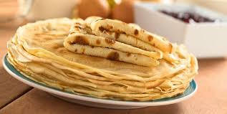
Les crêpes
Ingrédients
250 g de farine/250 g di farina
Une cuillère à soupe de sucre semoule/un cucchiaio di zucchero semolato
2 sachets de sucre vanillé/2 sacchetti di zucchero alla vanillina
Une pincée de sel/un pizzico di sale
½ l de lait/ ½ l di latte
Trois oeufs / tre uova
Trois cuillères à soupe d’huile/ tre cucchiai di olio
De beurre pour cuire/ del burro per la padella

Slide 2
PREPARATION
Mélanger la farine avec le sucre semoule, le sucre vanillé et le sel. Incorporer un quart de lait, puis les trois oeufs battus à la fourchette dans un bol, et l’huile. Bien mélanger, puis ajouter à nouveau ¼ de l de lait. La pâte à crêpes est prête !
Fondre du beurre dans une poêle, ajouter une cuillerée de pâte à crêpes et faire cuire deux minutes par côté. Servir les crêpes avec du sucre ou du chocolat fondu. Bon appétit!

Slide 3
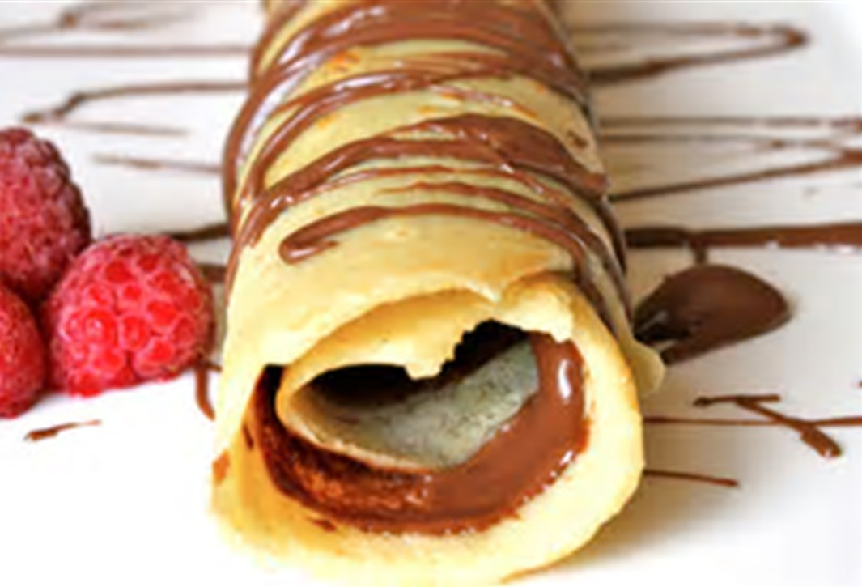
ITALIEN:
Mescolare la farina con lo zucchero semolato la vanillina e il sale.
Incorporare ¼ di l di latte, poi le tre uova sbattute con la forchetta in una ciotola e l’olio. Mescolare bene poi aggiungere un altro ¼ l di latte. La pasta è pronta!
Sciogliere il burro in una padella, aggiungere un cucchiaio della pasta delle crepe e lasciarla cuocere due minuti per lato.
Servire le crepe con lo zucchero oppure con del cioccolato fuso. Buon appetito!

Slide 4
British recipes

Slide 5
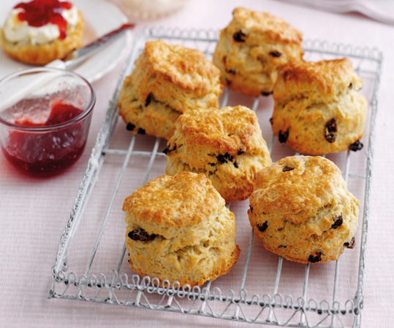
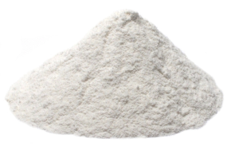
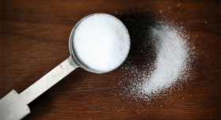
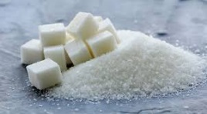
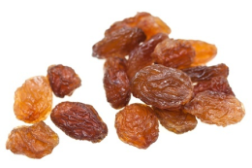
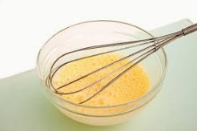
Fruit scones Cooking time 10 minutes Makes 10 scones
Ingredients:
75 g butter, cut into cubes, plus extra for greasing
350g plain flour, plus extra for dusting
1 ½ table spoon baking powder
30 g sugar
75 g sultanas
About 150ml milk
2 large eggs, beaten

Slide 6
Method:
Preheat the oven to 220°C . Lightly grease a large baking sheet.
Put the flour and baking powder into a large bowl.
Rub in the cubes of butter, add the sugar and sultanas.
Pour 100ml of the milk and all but 2 tablespoons of the beaten egg into the flour mixture.
Mix together to make a soft dough, adding a bit more milk if needed.
Turn the dough out onto a floured board, knead just a few times, then gently roll to form a rectangle about 2cm deep.
Cut into rounds and place on the baking sheet. Repeat until you have 10 scones.
Brush the tops of the scones with the reserved egg. Bake in a very hot oven for about 10 minutes, or until risen and golden.
Tips for great scones!
If you serve your scones split open, you can get lots of jam and cream.
They’re best served warm.

Slide 7
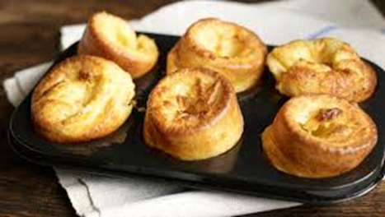
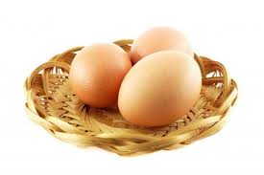
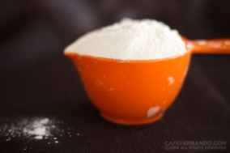
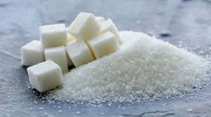
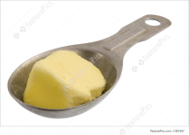
Yorkshire pudding Preparation 10 min. Cook 30 min.
Ingreients:
3 eggs
1 cup milk
1 cup flour
30 g sugar
2 tablespoons butter

Slide 8
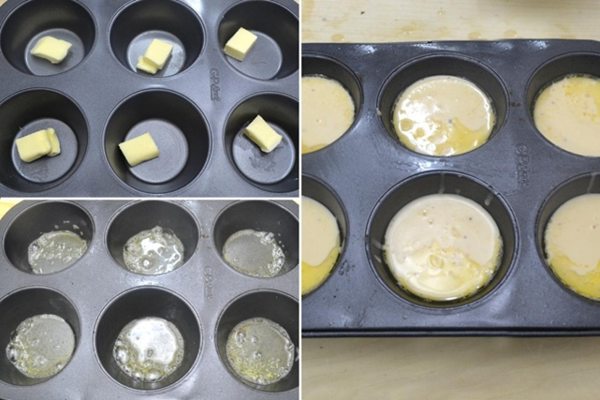
Directions:
1) Preheat oven to 190 degrees C.
2) In a medium bowl, beat eggs with milk. Stir in
flour. Set aside.
3) Divide butter evenly into the twelve cups of a
muffin tin, about 1/2 teaspoon per cup.
Place tin in oven to melt butter, 2 to 5 minutes. Remove tin from oven, and distribute batter evenly among buttery cups.
4) Bake in preheated oven 5 minutes. Reduce heat to 175 degrees C, and bake 25 minutes more or until puffed and golden.

Slide 9
thank you to get looked at!
Classe IIB

